Slide 1

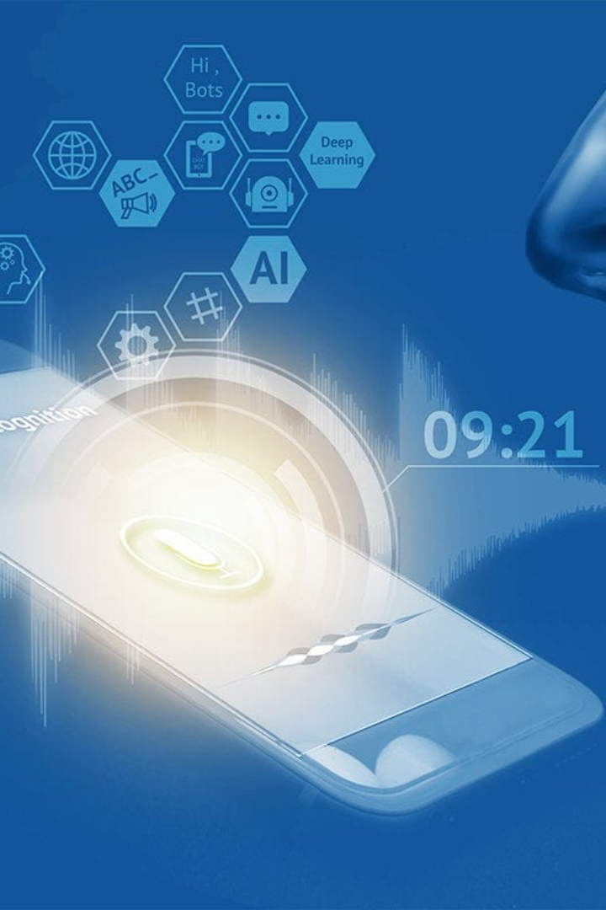
Speech to Text
Speech to text technology allows users to convert spoken words into written text, providing a convenient and efficient way to transcribe audio content.
Biradhar Nithin kumar

Slide 2

Speech to Text Technology in Daily Life
Virtual Assistants
Dictation Software
Language Learning
Speech to text enables voice commands and interactions with virtual assistants like Siri, Alexa, and Google Assistant.
Using speech to text, individuals can dictate emails, documents, and messages, improving writing speed and accuracy.
Speech to text helps language learners practice pronunciation and correct mistakes more effectively.

Slide 3
Benefits of Speech to Text Technology
Increased Productivity
Accessibility
Automated transcription speeds up the process of creating written documents, saving time and effort.
Speech to text makes content more accessible to individuals with hearing impairments or other disabilities.
Ease of Use
Language Support
Converting speech to text eliminates the need for manual typing, making it user-friendly for everyone.
Speech to text technology supports multiple languages, facilitating communication across borders and cultures.

Slide 4
Implementing Successful Speech to Text Systems
1
Data Collection
Ljspeech dataset contains 13,100 audio files, we use normalized transciption
Algorithms
2
Use state-of-the-art machine learning algorithms to improve speech recognition performance.
3
Training and Evaluating
A utility function to decode the output of the network, train the model and more

Slide 5
The Future of Speech to Text
1
Improved Accuracy
2
Integration with AI
3
Multi-Modal Communication
Speech to text will be seamlessly integrated with artificial intelligence, enabling advanced language processing capabilities.
Advancements in speech recognition technology will lead to even higher accuracy rates, minimizing errors.
Future developments will combine speech to text with other modalities, such as gesture recognition or facial expressions.

Slide 6
Challenges and Considerations
1
Accuracy
Speech recognition systems still face challenges in accurately transcribing diverse accents and speech patterns.
Privacy and Security
2
Transcribed speech may contain sensitive information, requiring robust security measures for data protection.
3
Adaptation to Context
Improving speech to text systems' ability to understand context and differentiate between speakers enhances overall accuracy.

Slide 7

Conclusion
Speech to text technology is revolutionizing the way we communicate and interact with digital devices. As advancements continue, we can expect even more accurate, efficient, and seamless speech recognition systems.

Slide 8
THANK YOU!
.

